Slide 1
Hyperbolic Space
Presenter: Kim Seung Hwan (overnap@khu.ac.kr)

Slide 2
Euclidean Geometry
5 Axioms of Euclidean Geometry
To draw a straight line from any point to any point.
To produce (extend) a finite straight line continuously in a straight line.
To describe a circle with any centre and distance (radius).
That all right angles are equal to one another.
That, if a straight line falling on two straight lines make the interior angles on the same side less than two right angles, the two straight lines, if produced indefinitely, meet on that side on which the angles are less than two right angles. (The parallel postulate)

Slide 3
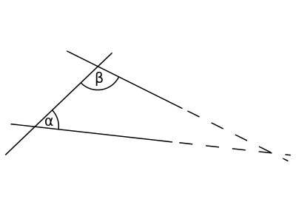
The Parallel Postulate
That, if a straight line falling on two straight lines make the interior angles on the same side less than two right angles, the two straight lines, if produced indefinitely, meet on that side on which the angles are less than two right angles.
So what does this mean anyway!?
This is equivalent to the propositions below:
Through a point not on a line, one and only one line can be drawn parallel to the given line
The sum of the interior angles of a triangle is two right angles

Slide 4
The Parallel Postulate
It turns out that the parallel postulate can be inverted
The geometry with inverted postulate is called “non-Euclidean”
Let us take a look one by one

Slide 5
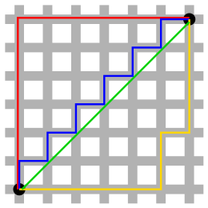
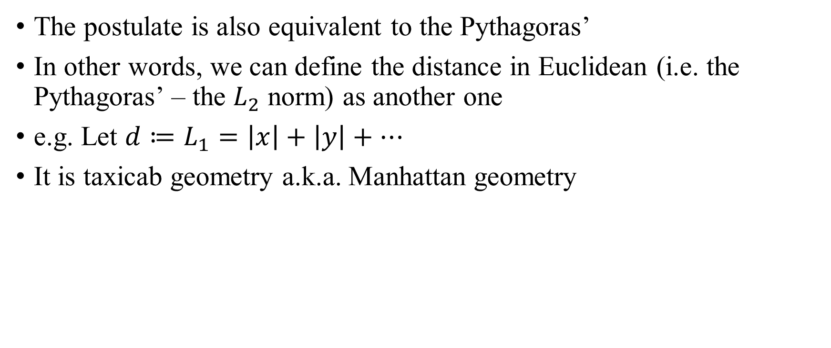
Taxicab Geometry
The postulate is also equivalent to the Pythagoras’
In other words, we can define the distance in Euclidean (i.e. the Pythagoras’ – the $L_{2}$ norm) as another one
e.g. Let $d≔L_{1}=\left|x\right|+\left|y\right|+…$
It is taxicab geometry a.k.a. Manhattan geometry

Slide 6
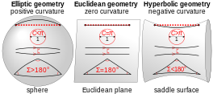
Riemannian Geometry
Let us get out of the flat plane
Riemann introduced the curvature and generalized a curved space
The discussion of this moves on to manifolds and Riemannian metric
…Let us understand it intuitively today

Slide 7
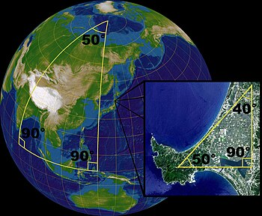
Elliptic Geometry
It has positive curvature
A parallel line does not exist (what?)
A triangle has interior angles whose sum is 180~540°
An easy and special example is a sphere

Slide 8
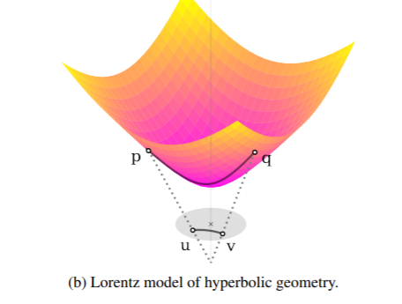
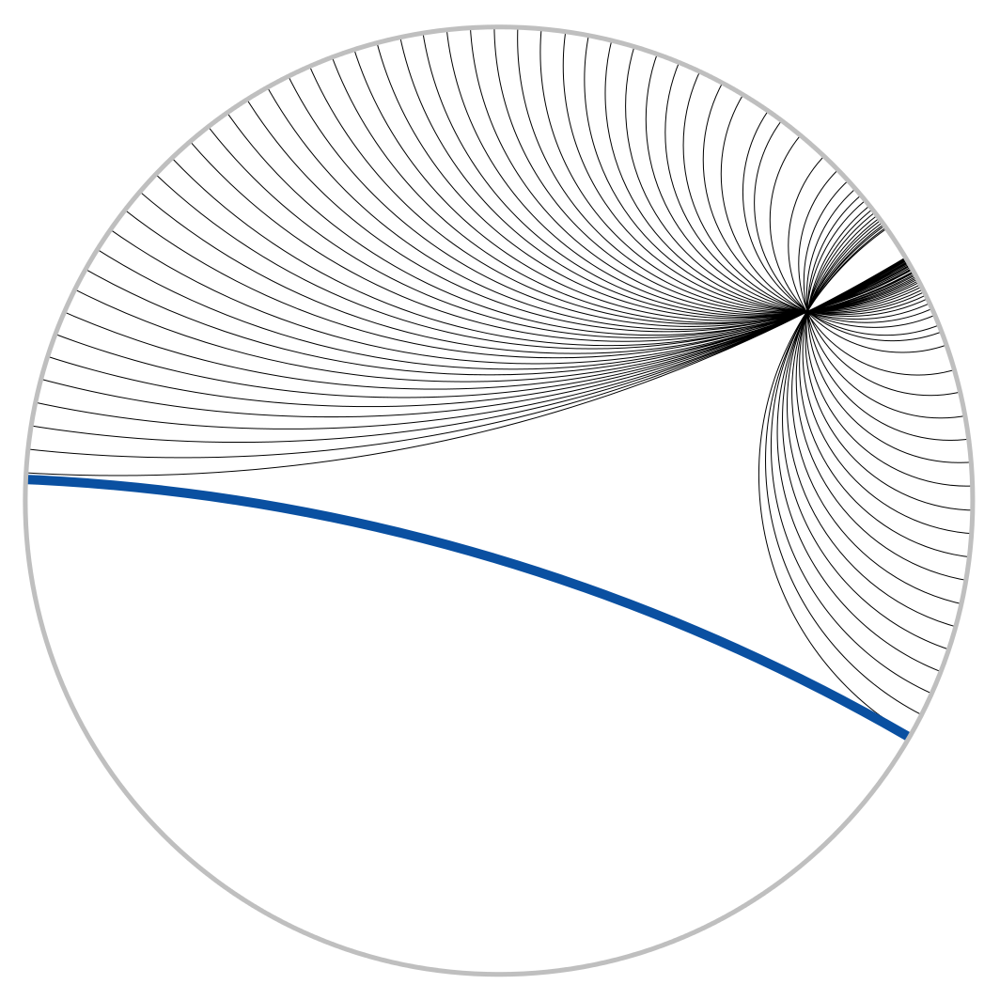
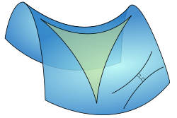
Hyperbolic Geometry
It has negative curvature
A parallel line exists, but it is not unique
In fact, there are infinite parallel lines

Slide 9
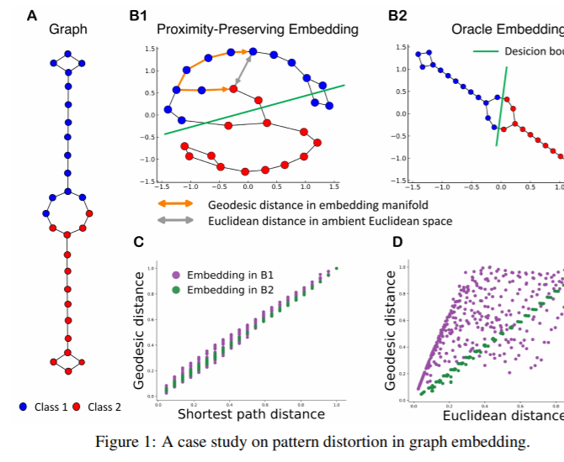
So Why Hyperbolic Embedding?
Euclidean space can be difficult
To contain the structure of data
Ok Euclidean can be bad
But why hyperbolic?

Slide 10
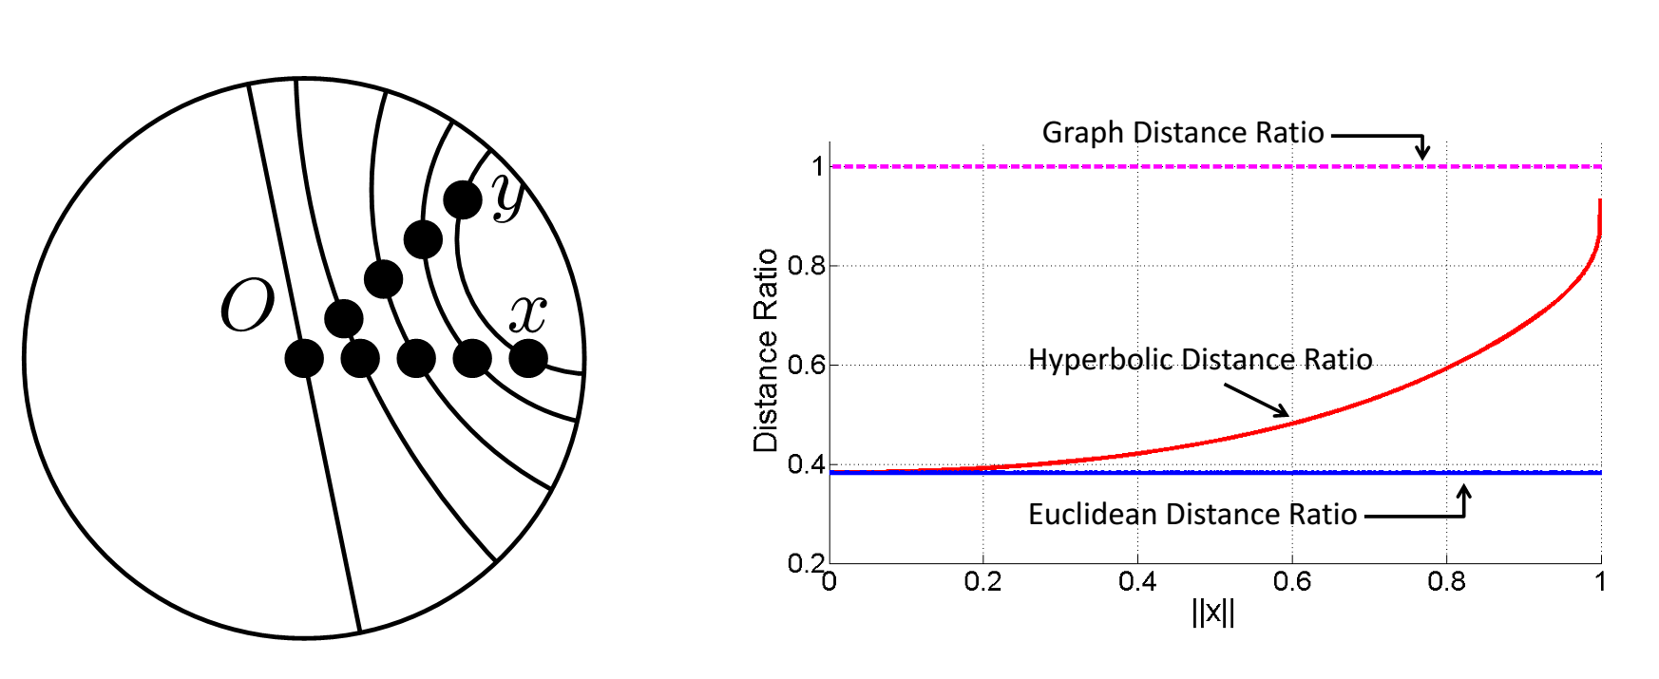
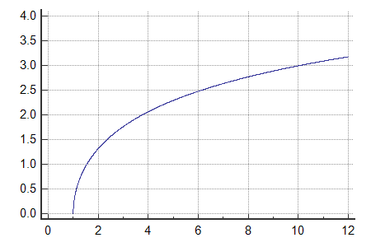


So Why Hyperbolic Embedding?
Consider mapping that preserves the graph distance
Graph distance means the shortest path on a graph
Consider $x, y$ and their parent $z$ in a tree

Slide 11
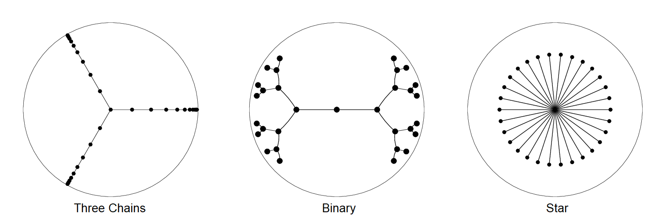
Tree Embedding
We can embed a tree to a low-dimension hyperbolic space
See "Sarkar, Rik. "Low distortion delaunay embedding of trees in hyperbolic plane." International symposium on graph drawing. Berlin, Heidelberg: Springer Berlin Heidelberg, 2011."
Embedding a tree means embedding a hierarchical structure
And arbitrary graph can be
See “Sala, Frederic, et al. "Representation tradeoffs for hyperbolic embeddings." International conference on machine learning. PMLR, 2018.”

Slide 12
Hyperbolic DNN
…But let us leave it at this point
So far, there are some intuitive takeaways anyway
Of course, the reason why they are so powerful is still not clear
Also, it is generally said that Euclidean becomes strong as the dimension increases
See “Peng, Wei, et al. "Hyperbolic deep neural networks: A survey." IEEE Transactions on pattern analysis and machine intelligence 44.12 (2021): 10023-10044.”
And “Mettes, Pascal, et al. "Hyperbolic Deep Learning in Computer Vision: A Survey." arXiv preprint arXiv:2305.06611 (2023).” if you are curious

Slide 13
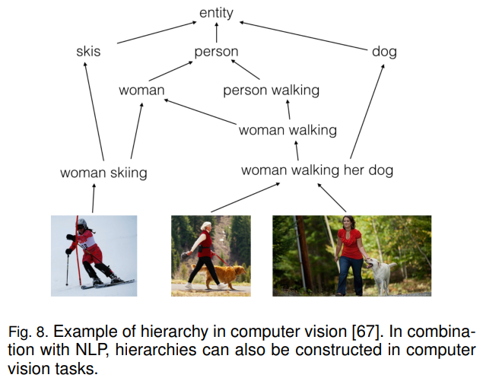
Hierarchical Structure
Hierarchical structures are evident in many datasets
Personally, I think trees and graphs are very, very powerful structures
I believe that trees are inherent in nature
The tree symbolizes logic and structure

Slide 14
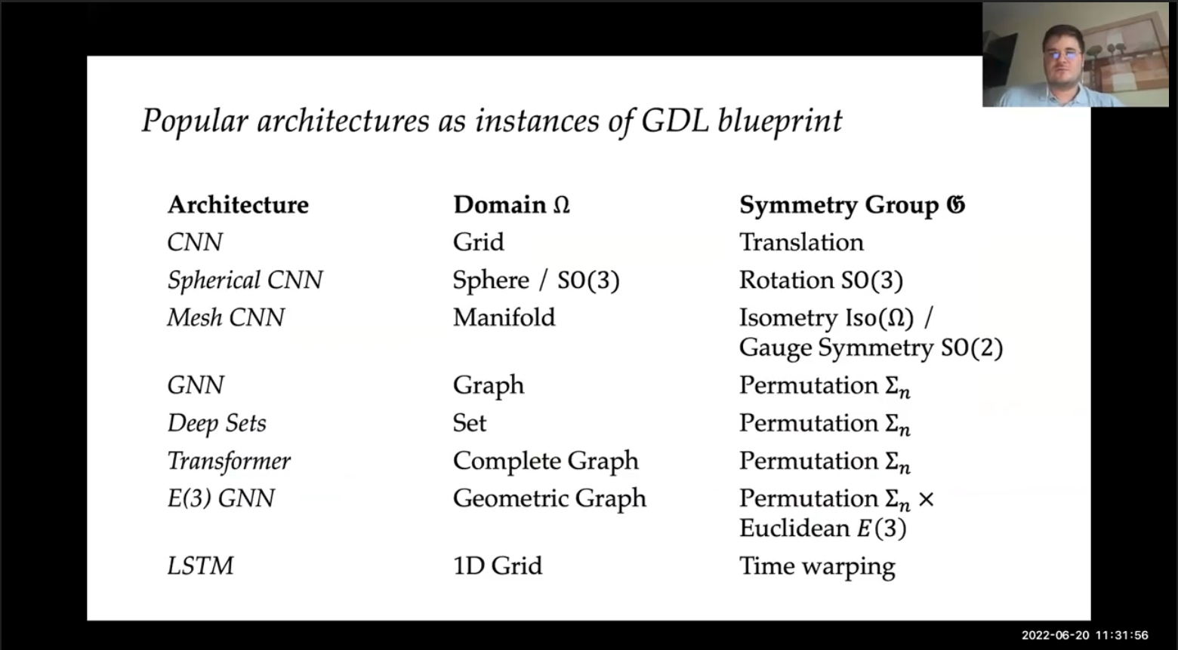
Hierarchical Structure
Additionally, recent papers often use non-Euclidean spaces (e.g. GNN)
I (and most people) are weak at math… I need to study a lot 😱

Slide 15
Thank you for listening
Presenter: Kim Seung Hwan (overnap@khu.ac.kr)

